Slide 1
This exercise program was developed and made available by the Missouri Hospital Association through funds from the ASPR Hospital Preparedness Program CFDA 93.889, through a subcontract from the Missouri Department of Health and Senior Services for the purposes of individual hospital preparedness and exercise. Sources used in the development of these materials are noted in the Notes Section except where general knowledge.

Slide 2
96 Hour Hospital Sustainability
Insert your hospital picture and name
Can We Make It?

Slide 3
Presenters
(List your exercise facilitator and any other presenters)

Slide 4
Objectives
Review the Joint Commission’s “96 hour rule”
Strategies to “go the distance”
Potential for earthquake in (your area) MO
Discuss strengths and weaknesses related to extended period without external resources
Discuss strategies and next steps to “mitigate” this type of event and future all hazards response

Slide 5
“96 Hour Rule” EM.02.01.01, EP3
Not a rule but a principle
It takes into account that the federal response in
large scale disaster will be 72 hours +++
Does not mandate building of additional storage
capacity or maintaining additional supplies
It is an attempt to have organizations do realistic
planning and develop a means to make realistic
decisions in advance of an event
Notes:
http://www.jointcommission.org/mobile/standards_information/jcfaqdetails.aspx?StandardsFAQId=523&StandardsFAQChapterId=63
The 96-hour Requirement
Current | March 09, 2009
Q. Are organizations required to have 96 hour capability on hand for the six critical areas regarding emergency response?
A. No, the Joint Commission does not expect this. The requirement is to determine whether the organization has the capability to sustain itself (independent or by the local community) for 96 hours. For example, most organizations do not have the fuel capacity, water for drinking and patient care, or water for process equipment and sanitation to sustain themselves for 96 hours. If it is determined, after all measures of conservation, curtailment, and support from outside of the community are exhausted, that the capability is only 80 hours, then evacuation would be an appropriate response.

Slide 6
6 Critical Components
1. Communications EM.02.02.01
2. Resources EM.02.02.03
3. Safety and Security EM.02.02.05
4. Staff Responsibilities EM.02.02.07
5. Utilities EM.02.02.09
6. Clinical Activities EM.02.02.11
Notes:
Source: Joint Commission Resources: 2014 Requirements Standards: Emergency Management (EM), p2.

Slide 7
Impact on Hospitals
Increased admissions
Decreased discharges
Traditional out patient services sought at the hospital
Chronically ill patients seeking support and medications
Citizens seeking non-healthcare services and shelter
Ever-increasing pressure put on limited resources
The question of “shelter in place” or “evacuation”

Slide 8
Common Characteristics of Significant Disasters
Sustained (lasts multiple days)
Affects multiple communities
Impacted or debilitated public services
Overwhelmed federal response
Threatened healthcare infrastructure

Slide 9
Impact on Health Care
Home Care closed
Long Term Care closed
Physician Offices closed
Outpatient Pharmacies closed
Dialysis Centers closed
Outpatient Cancer Centers closed
Special needs patients can not be supported at home
Discharged patients won’t leave the hospital

Slide 10
Strategies to Consider
Maintaining or expanding services
Conserving resources
Curtailing services
Obtaining additional resources from the community
Obtaining additional resources from outside the community
Closing the hospital to new patients
Staged or total evacuation
Notes:
Source: Joint Commission Resources: 2014 Requirements Standards: Emergency Management (EM), pp6-7.

Slide 11
Conservation of Resources
Know your current capabilities
Plan for interruption of supplies and services
Identify patients that can be discharged
Limit use of resources that cannot be replenished (fuel, water, supplies)
Plan for alternative methods to meet common
needs (gas generators, waste management)
Identify what utilities can be rationed and how
(air conditioning, waste water, linens)
Notes:
This slide details the Conservation of Resources Strategy

Slide 12
Curtailment of Services
Cancel elective surgeries
Shut down all non-essential services
Close selected clinics
Limit selected diagnostic testing as agreed to by
medical staff leadership (in advance of an event
where possible)
Notes:
This slide details the Curtailment of Services strategy

Slide 13
Consolidation of Resources
Know your inventory and usage rate
Construct estimates of usage rates during
emergencies
Ensure your critical equipment is compatible
with your planning partners
Know the realistic response of your vendors
Ensure that supplies and medications are
available from distant and disparate sources
Consider self-reliance strategies
Notes:
This slide details the Consolidation of Resources strategy. This is a good place to discuss your Inventory of Resources and expected time frames for durations.

Slide 14
Staged or Limited Evacuation
Identify criteria by which decisions will be made
(less than 12 hours of fuel, 70% of resources
consumed, etc.)
Determine these through exercises
Designate staff to accompany patients and
protect medical information
Identify transportation requirements to accepting
organization
Communicate decisions to staff and family

Slide 15
Full Evacuation
Cannot be done on the fly or out of desperation
Must have pre-determined criteria to activate
this plan that all staff are aware of
If evacuation is necessitated by an abrupt event,
have principles in place to guide staff
Must not lose track of patients or staff
Be prepared for the fallout that such an event
will generate (media, liability, insurance
coverage, loss of revenue, impact on staff)

Slide 16
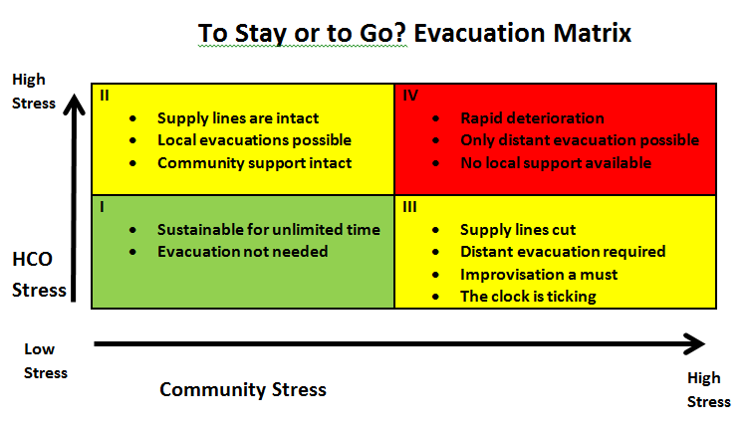

Slide 17
Background
Small earthquakes and tremors occur frequently in Missouri.
Thousands of quakes since 1795
Missouri is home to the New Madrid Fault
Earthquakes along this fault in 1811-12 caused major damage and loss of life
Bells rang in Boston
Notes:
http://www.dnr.mo.gov/geology/geosrv/geores/historymoeqs.htm
Small earthquakes and tremors occur frequently in Missouri. Thousands of quakes have been noted in the state since 1795 and have been recorded since 1908. In recent times, earthquakes have been known to rock tall buildings and crack plaster in Missouri homes. Most were accompanied by numerous aftershocks, which are a series of successive quakes that can cause more damage than the initial shock.

Slide 18
Notes:
Source: Presentation: CUSEC, the NMSZ, and the 2011 Earthquake Exercise
Paul Hogue, Exercise Training Officer, CUSEC
http://www.dnr.mo.gov/geology/geosrv/geores/historymoeqs.htm
A series of three to five major earthquakes (magnitude 7.0 or larger earthquakes) occurred in the NMSZ in the two month period between Dec. 16, 1811 and February 7, 1812. Several thousand additional “smaller” earthquakes occurred during the three month period from Dec. 16, 1811 to March 16, 1812. These included 15 quakes of magnitude 6.5 to 8 (the size range of the 1989 San Francisco, 1994 Los Angeles and 1995 Kobe, Japan earthquakes) and 189 quakes of magnitude 5 to 6.5. Two thousand of these quakes were felt by people, indicated by crude seismograph instruments and recorded in personal journals at Louisville, Kentucky and Cincinnati, Ohio, which are respectively 250 and 350 miles away. The New Madrid area was at the very frontier of European settlement at this time so there were very few non-native Americans living in the immediate area to report the earthquakes.
In the past 25 years, scientists have learned that strong earthquakes in the central Mississippi Valley are not freak events but have occurred repeatedly in the geologic past.
Geologic studies indicate large earthquakes occurred within the southeastern Missouri region in approximately 300, 900, and 1400 AD. Lesser quakes M 4.6 or smaller occurred in 1990, 1992, 1998 and 2003 in areas ranging from central Missouri to the Bootheel in the southeastern Missouri.

Slide 19
Notes:
Source: Presentation: CUSEC, the NMSZ, and the 2011 Earthquake Exercise
Paul Hogue, Exercise Training Officer, CUSEC

Slide 20
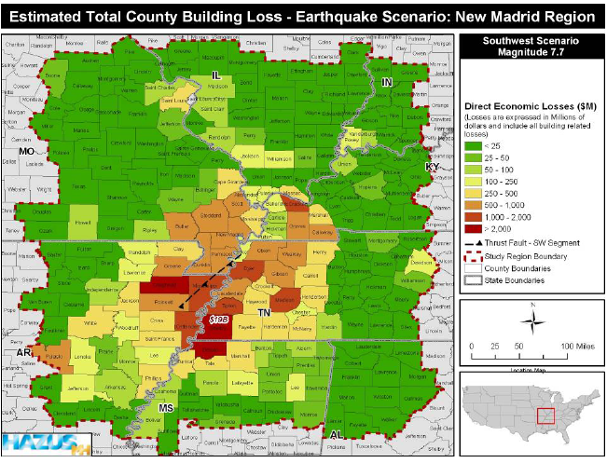
Notes:
Source: Presentation: CUSEC, the NMSZ, and the 2011 Earthquake Exercise
Paul Hogue, Exercise Training Officer, CUSEC

Slide 21
Notes:
Source: Presentation: CUSEC, the NMSZ, and the 2011 Earthquake Exercise
Paul Hogue, Exercise Training Officer, CUSEC

Slide 22
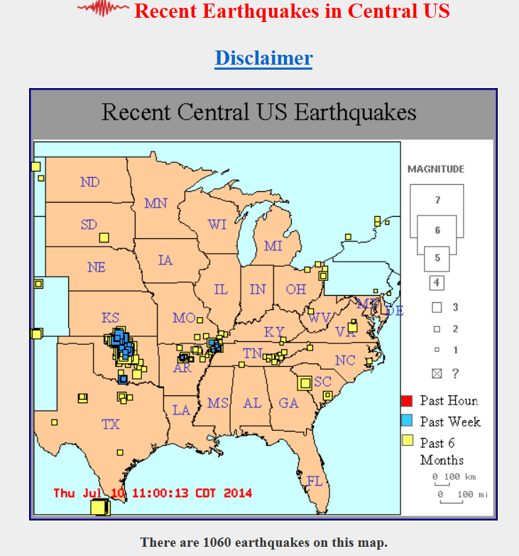
Notes:
http://folkworm.ceri.memphis.edu/recenteqs/
http://www.dnr.mo.gov/geology/geosrv/geores/historymoeqs.htm
About 200 shocks are detected annually in the New Madrid Seismic Zone (or Central United States Seismic Zone).

Slide 23
Notes:
http://folkworm.ceri.memphis.edu/recenteqs/Maps/90-37.html
Update time = Thu Jul 10 11:00:13 CDT 2014 Here are the 30 most recent earthquakes and all M>3 earthquakes on this map...
MAG DATE LOCAL-TIME LAT LON DEPTH LOCATION y/m/d h:m:s deg deg km 1.7 2014/07/07 16:23:19 36.025N 89.862W 9.4 12 km ( 7 mi) NNE of Blytheville, AR 1.3 2014/07/05 03:45:21 36.309N 89.511W 8.1 5 km ( 3 mi) NNW of Ridgely, TN 1.1 2014/07/04 23:49:56 36.445N 89.543W 8.2 10 km ( 6 mi) NW of Tiptonville, TN 1.8 2014/07/04 10:31:41 36.132N 89.416W 3.6 11 km ( 7 mi) NNW of Dyersburg, TN 2.8 2014/07/04 08:41:47 36.556N 90.017W 7.7 16 km (10 mi) NW of Gideon, MO 1.4 2014/07/02 17:39:43 36.539N 89.602W 8.1 8 km ( 5 mi) SW of New Madrid, MO 1.4 2014/06/30 20:00:28 36.471N 89.562W 8.4 13 km ( 8 mi) NW of Tiptonville, TN 1.4 2014/06/30 12:13:06 36.549N 89.640W 9.7 11 km ( 7 mi) WSW of New Madrid, MO 1.1 2014/06/27 19:17:00 36.399N 89.603W 11.6 9 km ( 6 mi) ESE of Portageville, MO 1.4 2014/06/27 13:51:46 36.543N 89.674W 7.9 13 km ( 8 mi) N of Portageville, MO 2.0 2014/06/25 23:04:21 36.069N 89.811W 9.2 17 km (11 mi) NNE of Blytheville, AR 2.9 2014/06/25 04:47:55 36.107N 89.407W 9.6 8 km ( 5 mi) NNW of Dyersburg, TN 2.0 2014/06/23 23:32:18 36.110N 89.746W 6.3 12 km ( 7 mi) SW of Caruthersville, MO 2.5 2014/06/21 17:39:33 36.051N 89.824W 9.2 18 km (11 mi) NE of Gosnell, AR 1.5 2014/06/21 00:38:00 36.489N 89.554W 8.1 11 km ( 7 mi) SSW of New Madrid, MO 1.5 2014/06/20 05:40:55 36.531N 89.638W 7.2 12 km ( 7 mi) WSW of New Madrid, MO 1.3 2014/06/18 06:52:25 36.176N 89.464W 9.2 10 km ( 6 mi) SSE of Ridgely, TN 1.6 2014/06/17 20:26:05 36.557N 89.621W 8.9 9 km ( 6 mi) WSW of New Madrid, MO 1.1 2014/06/16 02:09:43 36.267N 89.470W 6.2 2 km ( 1 mi) ENE of Ridgely, TN 1.3 2014/06/15 01:50:07 36.284N 89.525W 3.3 4 km ( 2 mi) NW of Ridgely, TN 1.6 2014/06/14 06:54:26 36.464N 89.576W 10.5 12 km ( 7 mi) ENE of Portageville, MO 1.6 2014/06/14 05:48:51 36.216N 89.465W 7.9 6 km ( 3 mi) SSE of Ridgely, TN 1.9 2014/06/11 06:57:34 36.231N 89.484W 5.7 13 km ( 8 mi) NNE of Alamo, TN 1.1 2014/06/10 01:33:31 36.312N 89.536W 8.8 7 km ( 4 mi) NW of Ridgely, TN 1.9 2014/06/09 21:18:14 36.109N 89.402W 8.8 9 km ( 5 mi) N of Dyersburg, TN 0.9 2014/06/09 00:27:54 36.475N 89.572W 9.3 13 km ( 8 mi) ENE of Portageville, MO 1.8 2014/06/02 20:19:04 36.077N 89.433W 3.8 8 km ( 5 mi) NW of Dyersburg, TN 1.8 2014/05/31 11:14:49 36.600N 89.566W 4.6 4 km ( 2 mi) WNW of New Madrid, MO 2.2 2014/05/28 23:07:57 36.294N 89.463W 5.3 4 km ( 2 mi) NE of Ridgely, TN 1.4 2014/05/28 03:28:13 36.494N 89.546W 8.2 10 km ( 6 mi) S of New Madrid, MO 3.1 2014/05/15 10:44:58 36.558N 90.020W 5.7 15 km ( 9 mi) NW of Gideon, MO 3.1 2014/04/07 01:24:12 36.215N 89.410W 6.1 8 km ( 5 mi) ESE of Ridgely, TN

Slide 24
Earthquake Plan
Provide a brief review of your Earthquake Plan

Slide 25
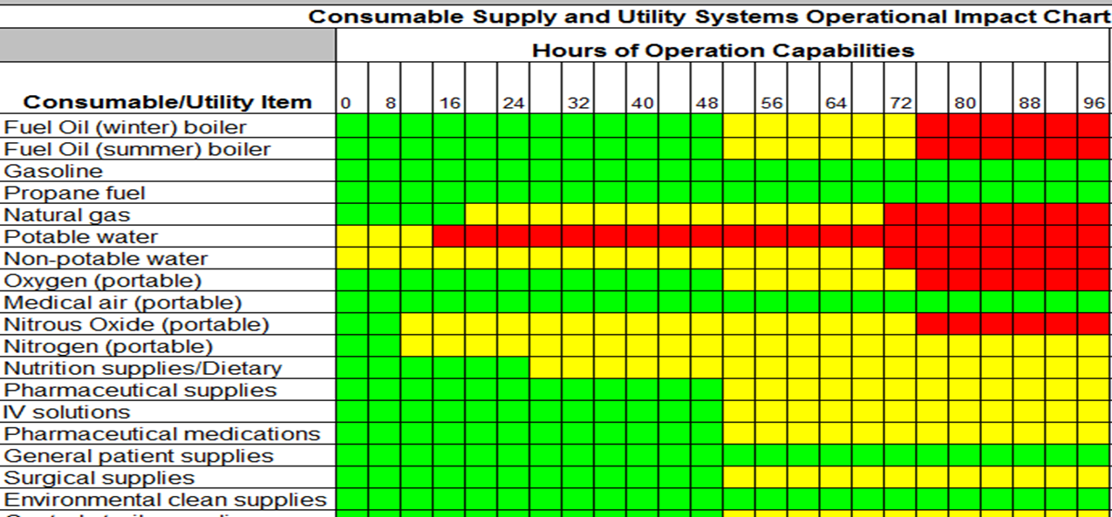
96 Hour Sustainability
Provide a brief overview of your Emergency Management Assets and Resources Inventory Summary

Slide 26
Exercise Objectives
Test the ability of the hospital to maintain operations when the hospital can not be supported by the local community in the following areas:
Communications
Resources and assets
Security and safety
Staff Responsibilities
Utilities
Clinical activities
IT

Slide 27
Exercise Participants
List Participants

Slide 28
Exercise Format
Four segments of scenario that will progress across 4 days
(Choose either full group discussion or breakout groups with random or targeted participants)
Breakout groups:
Groups will be asked to discuss what their response would be to the given scenario in the form of questions
Choose a recorder to document answers and report back to the group

Slide 29
DAY 1
Monday morning, 9:00am, a major earthquake registering 8.5 hits Southeast Missouri along the New Madrid Fault line.
Damage across the state is widespread with areas in the Bootheel and St. Louis being devastated with loss of life and most homes and facilities suffering major damage to total loss.
There are thousands with mild to severe injuries.
Thousands are reported dead.
Power is out throughout the central part of the United States.

Slide 30
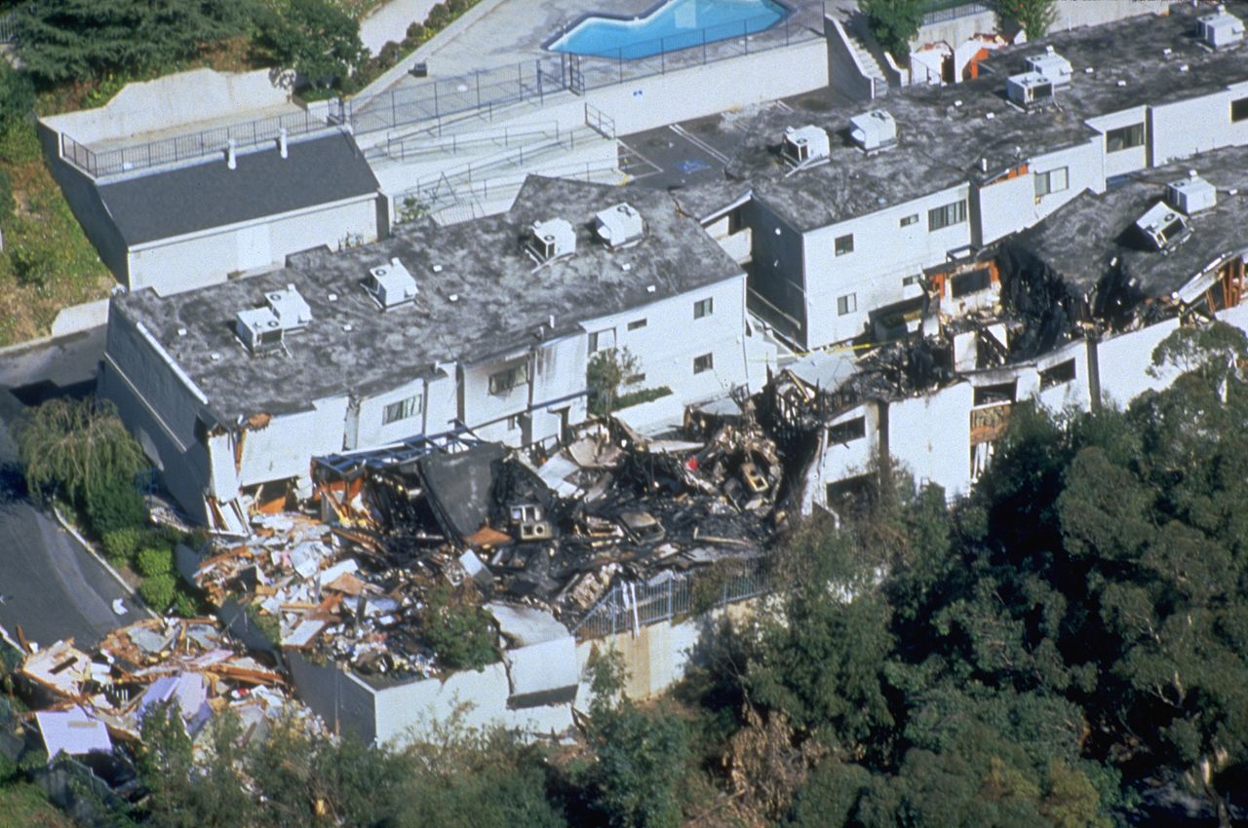
Notes:
FEMA - 1681 - Photograph by FEMA News Photo taken on 01-17-1994 in California. North Ridge, CA Earthquake. Public Domain
DescriptionFEMA - 1681 - Photograph by FEMA News Photo taken on 01-17-1994 in California.jpgEnglish: Northridge Earthquake, CA, January 17, 1994 -- An aerial view of destruction caused by the 6.7 magnitude earthquake. Approximately 114,000 residential and commercial structures were damaged and 72 deaths were attributed to the earthquake. Damage costs were estimated at $25 billion. FEMA News Photo
Date17 January 1994SourceThis image is from the FEMA Photo Library.AuthorFEMA News Photo
http://commons.wikimedia.org/wiki/File:FEMA_-_1681_-_Photograph_by_FEMA_News_Photo_taken_on_01-17-1994_in_California.jpg
Photos included in this presentation are taken of the Northridge California Earthquake on January 17, 1994 at 4:30am local time. Magnitude 6.7.
“Sixty people were killed, more than 7,000 injured, 20,000 homeless and more than 40,000 buildings damaged in Los Angeles, Ventura, Orange and San Bernardino Counties. Severe damage occurred in the San Fernando Valley: maximum intensities of (IX) were observed in and near Northridge and in Sherman Oaks. Lesser, but still significant damage occurred at Fillmore, Glendale, Santa Clarita, Santa Monica, Simi Valley and in western and central Los Angeles. Damage was also sustained to Anaheim Stadium. Collapsed overpasses closed sections of the Santa Monica Freeway, the Antelope Valley Freeway, the Simi Valley Freeway and the Golden State Freeway. Fires caused additional damage in the San Fernando Valley and at Malibu and Venice. Preliminary estimates of damage are between 13 and 20 billion U.S. dollars. Felt throughout much of southern California and as far away as Turlock, California; Las Vegas, Nevada; Richfield, Utah and Ensenada, Mexico. The maximum recorded acceleration exceeded 1.0g at several sites in the area with the largest value of 1.8g recorded at Tarzana, about 7 km south of the epicenter. A maximum uplift of about 15 cm occurred in the Santa Susana Mountains and many rockslides occurred in mountain areas, blocking some roads. Some ground cracks were observed at Granada Hills and in Potrero Canyon. Some liquefaction occurred at Simi Valley and in some other parts of the Los Angeles Basin. “
Source: http://earthquake.usgs.gov/earthquakes/states/events/1994_01_17.php

Slide 31
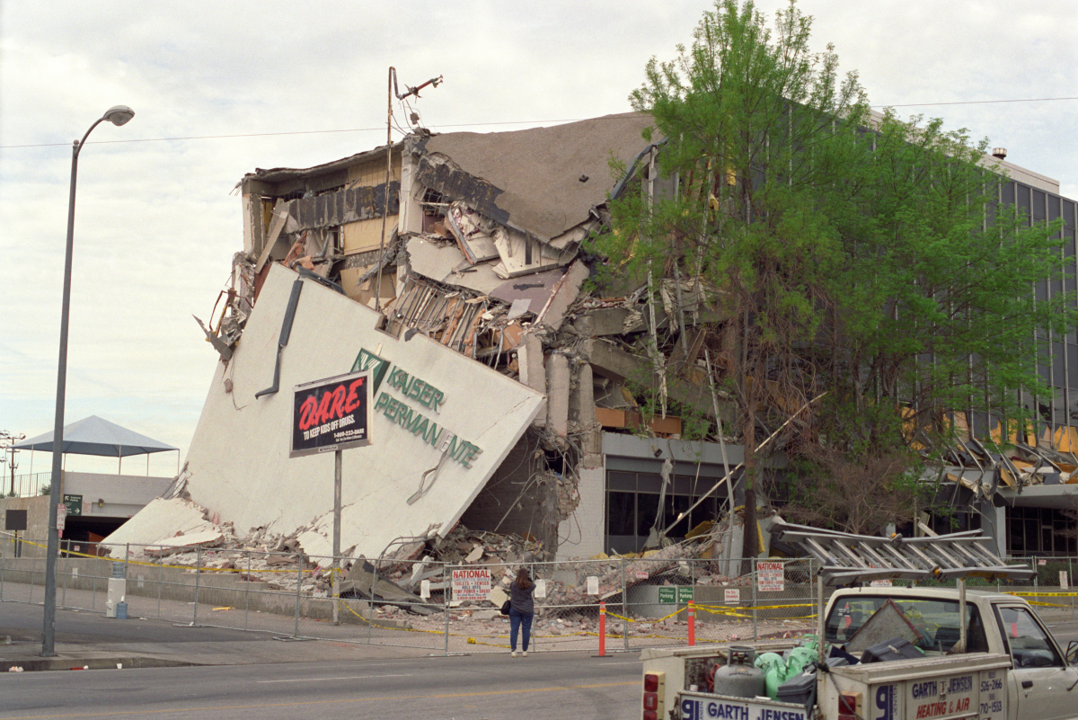
Notes:
Kaiser Permanente Building After Northridge EarthquakePublic Domainview terms
Gary B. Edstrom - Photo by Gary B. Edstrom. Transferred from earlier upload at en.wikipedia
Kaiser Permanente building
The Kaiser Permanente Building after the Northridge Earthquake of January 17, 1994. Photo taken on Saturday, January 22, 1994 by me, Gary B. Edstrom, and released to the public domain.
http://en.wikipedia.org/wiki/1994_Northridge_earthquake#mediaviewer/File:Kaiser_Permanente_Building_After_Northridge_Earthquake.jpg

Slide 32
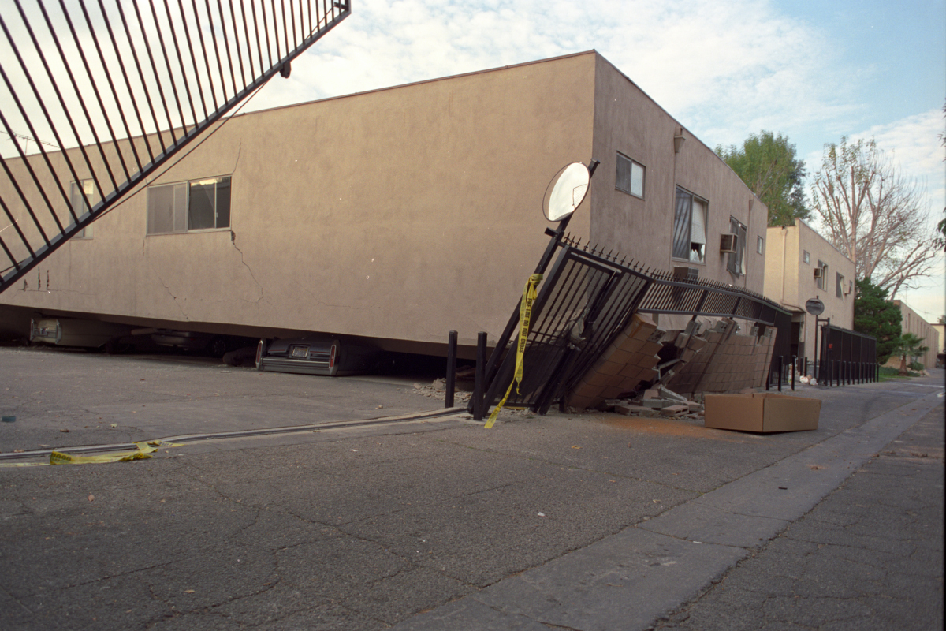
Notes:
Collapsed Apartment After Northridge Earthquake Public Domain view terms
Original uploader was Gedstrom at en.wikipedia - See above. Transferred from en.wikipedia
Collapsed apartment building
Collapsed apartment building after the Northridge Earthquake of January 17, 1994. Photo taken Saturday, January 22, 1994 by me, Gary B. Edstrom, and released to the public domain.
http://en.wikipedia.org/wiki/1994_Northridge_earthquake#mediaviewer/File:Collapsed_Apartment_After_Northridge_Earthquake.jpg

Slide 33
Day 1
Natural gas pipelines in central Missouri, St. Louis, and the bootheel have been severed.
Bridges are closed across the rivers in St. Louis, St. Charles, Jefferson City, Boonville, and I-70 at the Boone/ Cooper County lines as they are deemed unsafe. (can customize to affect your area)
Many bridges in (your )County have suffered damage and their safety is unknown.

Slide 34
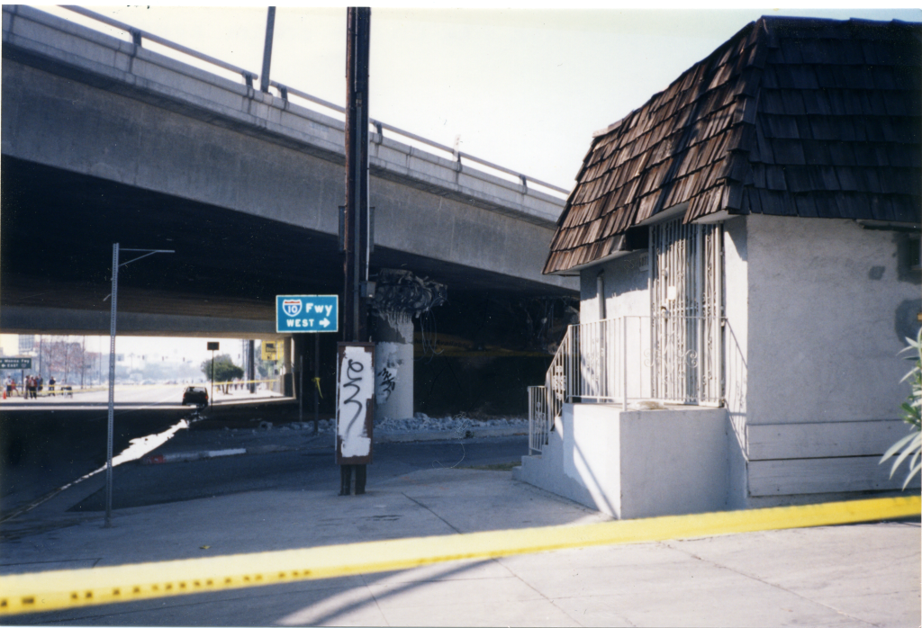
Notes:
Northridge earthquake 10 frwy CC BY-SA 3.0 view terms – No changes to the photo have been made.
FEMA News Photo - This image is from the FEMA Photo Library
http://en.wikipedia.org/wiki/1994_Northridge_earthquake#mediaviewer/File:Northridge_earthquake_10_frwy.png

Slide 35
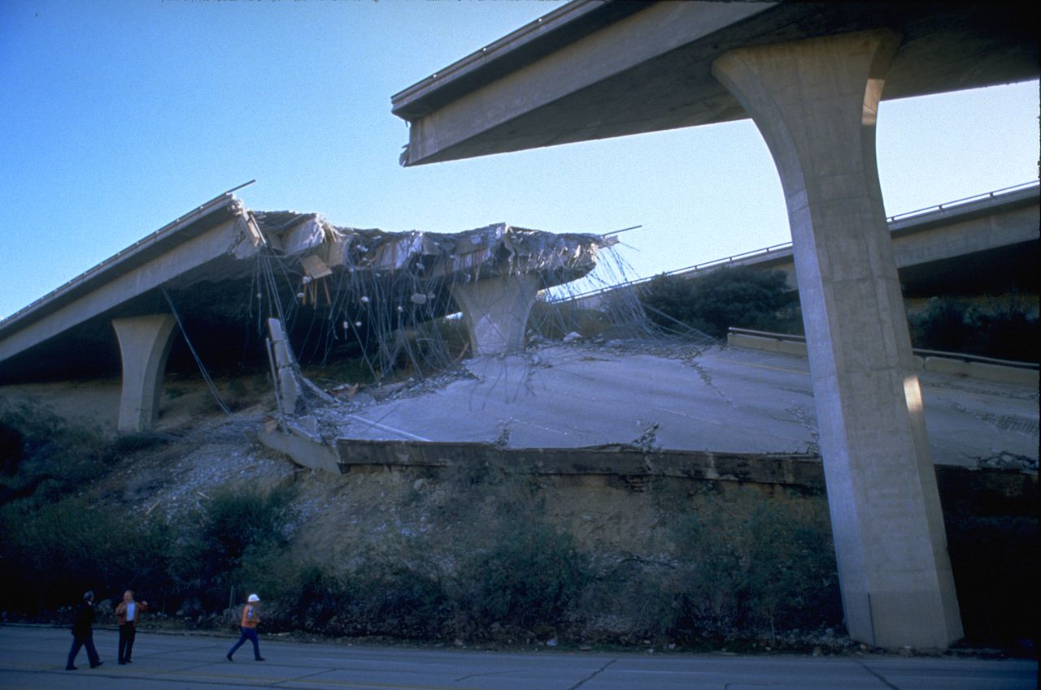
Notes:
FEMA - 1807 - Photograph by Robert A. Eplett taken on 01-17-1994 in California Public Domain view terms
Robert A. Eplett - This image is from the FEMA Photo Library.
DescriptionFEMA - 1807 - Photograph by Robert A. Eplett taken on 01-17-1994 in California.jpgEnglish: Northridge Earthquake, CA, January 17, 1994 -&#65533; Many roads, including bridges and elevated highways were damaged by the 6.7 magnitude earthquake. Approximately 114,000 residential and commercial structures were damaged and 72 deaths were attributed to the earthquake. Damage costs were estimated at $25 billion. FEMA News Photo
Date17 January 1994SourceThis image is from the FEMA Photo Library.AuthorRobert A. Eplett
http://en.wikipedia.org/wiki/1994_Northridge_earthquake#mediaviewer/File:FEMA_-_1807_-_Photograph_by_Robert_A._Eplett_taken_on_01-17-1994_in_California.jpg

Slide 36
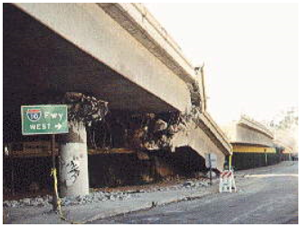
Notes:
https://www.fhwa.dot.gov/publications/publicroads/94summer/p94su26.cfm
Cooper, James D., Fiedland, Ian M., Buckle, Ian G., Nimis, Ronald B., and Bobb, Nancy McMullin. Summer, 1994, Vol. 58, No. 1. US Department of Transportation, Federal Highway Administration. Public Roads.
Collapsed section of westbound Santa Monica Freeway (I-10) between Venice Blvd and LaCienega.

Slide 37
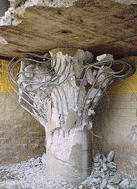
Notes:
Source: https://www.fhwa.dot.gov/publications/publicroads/94summer/p94su26.cfm
Cooper, James D., Fiedland, Ian M., Buckle, Ian G., Nimis, Ronald B., and Bobb, Nancy McMullin. Summer, 1994, Vol. 58, No. 1. US Department of Transportation, Federal Highway Administration. Public Roads.
Crushed column supporting the Santa Monica Freeway (I-10) near Venice Blvd. Pre-1971 column designs did not provide sufficient concrete-core confinement and resulted in “birdcaging” effect of steel reinforcement.

Slide 38
Day 1
Communications networks across the state are non-functional including cell phone, radio, and telephone.
(your) internal radio systems are working.
Sewer systems become non-functional due to loss of power to sewage lift stations.
The temperature today is 68 degrees with an expected high of 85.

Slide 39
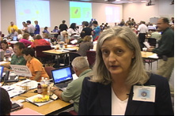
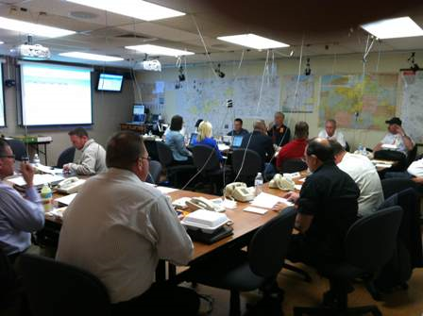
Day 1
Local (LEOC) and State Emergency Operations Centers (SEOC) are being activated to manage this disaster. The regional Multi Area Coordination Center is also being activated. (MACC)
Regional Healthcare Coalitions across the state have activated virtually through EMResource and e-ICS.
Search and rescue and road and bridge opening are their primary objectives at this time.
Notes:
http://www.momissioncast.com/?m=200706
Source: http://www.wd8aye.net/AirportDrill2012.jpg

Slide 40
DAY 1: (Your) Situation
(list your areas or facilities) are without electrical power.
Emergency generators at the inpatient facility(ies) are functional and running.
Many employees are unable to get to work due to the inability to travel on debris covered roads and unsafe bridges.
100% of homes and businesses in the county are without power.
Assume normal levels of staff, food, supplies, medications, linens, generator fuel, and medical gases.
People who can get to the hospital begin to arrive with mostly minor injuries. Two crush injury victims have been brought in from surrounding neighborhoods.

Slide 41
(Your Facility) Patient Census
(list departments and typical census)

Slide 42
DAY 1 Questions
How will this situation affect the hospital?
Patient Care
Food
Utilities
Communication
Security and Safety
Staffing
IT
Respiratory Therapy
How will the hospital coordinate it’s activities?
What are the hospital incident objectives at this time?
What strategies should be implemented to continue operations?

Slide 43
Day 2
Hospitals in the heaviest hit areas (St. Louis and southeastern Missouri) require evacuation as they are not structurally sound and have lost critical utilities.
Parking garages have collapsed and structurally failed.
Utilities, including power, communications, water, and oxygen, were lost.
Notes:
During the 1994 Northridge Earthquake, nonstructural damage caused temporary closure, evacuation, or patient transfer at ten essential hospital facilities. These hospitals generally had little or no structural damage but were rendered temporarily inoperable, primarily because of water damage. At the majority of these facilities, water leaks occurred when fire sprinkler, chilled-water, or other pipelines broke. In some cases, personnel were unavailable or unable to shut off the water, and water was flowing for many hours. At one facility, water up to 2 feet deep was reported at some locations in the building as a result of damage to the domestic water supply tank on the roof. At another facility, the emergency generator was disabled when its cooling water line broke where it crossed a separation joint. Other damage at these facilities included broken glass, dangling light fixtures, elevator counterweight damage, and lack of emergency power due to failures in the distribution or control systems. Two of these facilities, shown in the following figures, Los Angeles County Olive View Medical Center and Holy Cross Medical Center, both in Sylmar, California, that had suffered severe structural damage or collapse during the 1971 San Fernando Earthquake had been demolished and entirely rebuilt by the time of the 1994 Northridge Earthquake (Reitherman, 1994). http://www.fema.gov/earthquake/fema-e-74-reducing-risks-nonstructural-earthquake-damage-chapter-24-importance

Slide 44
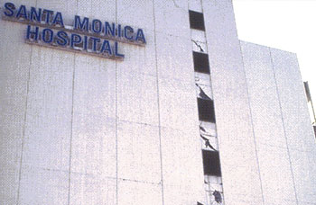
Notes:
Damage in Santa Monica The hospital in Santa Monica shows classic "X"-pattern cracks as evidence of the damage it sustained during the Northridge earthquake. (photo: Gregory Davis)

Slide 45
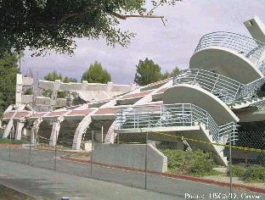
Collapsed Northridge Parking Structure. Photo Courtesy of U.S. Geological Survey.
Notes:
Collapsed Northridge Parking Structure. Photo Courtesy of U.S. Geological Survey.

Slide 46
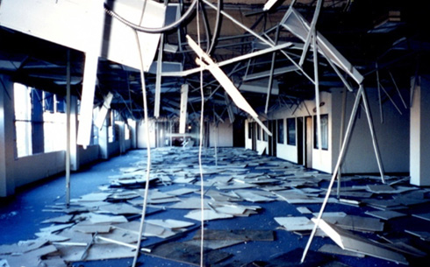
Notes:
Figure 2.4.2-1 Complete loss of suspended ceilings and light fixtures in the 1994 Northridge Earthquake (FEMA 74, 1994.)
http://www.fema.gov/earthquake/fema-e-74-reducing-risks-nonstructural-earthquake-damage-chapter-24-importance

Slide 47
DAY 2
Aftershocks are felt across the state causing additional damage to already damaged buildings, roads, and bridges.
The roads are still covered with debris and bridges are not expected to open for several more days.
The City of (XXXXX) has announced that they will be suspending trash pick up until further notice.
Medical gas companies report they will not be able to deliver bulk oxygen or tanks until the roads open.
300 homes in (your) County have been completely destroyed.
200 reported injured, 100 dead.
Bodies are still being found in debris.

Slide 48
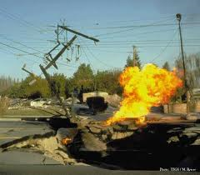
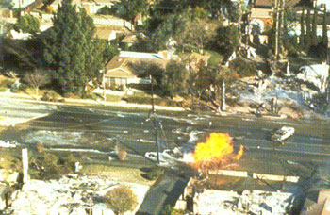
Day 2
Gas pipelines in (your area) Missouri have ruptured causing fires.
Water lines have ruptured also. Boil orders are in effect in areas that still have water.
Notes:
Photo 2: Damage on Balboa Boulevard Both gas and water pipes burst beneath Balboa Boulevard north of the Simi Valley Freeway from the force of the main shock, creating this bizarre and destructive combination of fire and water. (photo: Kerry Sieh) http://www.data.scec.org/significant/northridge1994.html#a

Slide 49
Day 2
Initial damage assessments to (your facility) indicate severe structural damage to the (list areas).
A crack in the oxygen line from the bulk tank has been discovered.
Water from the city has been cut off.
Suppliers notify the hospital that they will not be making deliveries until the roads and bridges are reopened.

Slide 50
Day 2
Additional patients arrive with a variety of injuries from minor cuts and bruises to broken bones and crush injuries and burns.
Additional patients are being seen who have special needs (ventilators, dialysis machines, other respiratory equipment) but normally stay in their home.
The local EOC is telling people to go to your nearest hospital if you need any type of medical attention.
Many staff are unable to go home or come into work due to the roads.
Some staff have lost their homes or loved ones.

Slide 51
DAY 2 Questions
How will this situation affect the hospital?
Patient Care
Food
Utilities
Communication
Security and Safety
Staffing
IT
Respiratory Therapy
What are the hospital incident objectives at this time?
What strategies should be implemented to continue operations?

Slide 52
DAY 3: (your facility) Situation
Emergency generators continue to run for the hospital.
(Fuel Suppliers) report that they will not be able to deliver fuel for 3 more days.
A major structural crack has been identified in (support building).
The latest set of aftershocks has caused the roof to collapse in the (list building).
Patients continue to find ways to the hospital with increasing issues with chronic conditions; no medications, no oxygen, or power for medical equipment. The hospital is currently at 110% capacity, with more in the ED waiting room.
50% of the bridges in (your) County have been certified as “safe”.
Bridges over the rivers are still closed.

Slide 53
Day 3
The area is expecting it’s first heat wave of the summer with highs today predicted to reach 95 degrees.

Slide 54
DAY 3: Questions
How will this situation affect the hospital?
Patient Care
Food
Utilities
Communication
Security and Safety
Staffing
IT
Respiratory Therapy
What are the hospital incident objectives at this time?
What strategies should be implemented to continue operations?

Slide 55
DAY 4
Staff are starting to show signs of stress at the long hours, limited resources, and overcrowded condition of the hospital.
Power, communications, water, sewer, linens, and supply deliveries have still not been restored. They hope to have most utilities up and running tomorrow.
Most roads and bridge in central to western Missouri should be opening by tomorrow.

Slide 56
City/County EOC
The City/County EOC informs you that reimbursement for disaster expenses may be possible, IF the expenses were tracked from the beginning of the disaster

Slide 57
DAY 4: Questions
How will this situation affect the hospital?
Patient Care
Food
Utilities
Communication
Security and Safety
Staffing
IT
Respiratory Therapy
What are the hospital incident objectives at this time?
What strategies should be implemented to continue operations?

Slide 58
What have we learned?
What went well?
What did not go well?
What do we need to do to ensure we are ready should this happen in real life?

Slide 59
Questions?
Thank you for your participation!
Please complete your Participant Evaluation Form and return for inclusion in the After Action Report.

