Slide 1
The State of COVID-19 in Missouri: July 13, 2021
Currently one of the “hottest” spots on the planet
Driven by low vaccination rates and prevalence of the dominant Delta variant
Case growth and hospitalizations are increasing rapidly, primarily in the Southwest Region
Currently ~1,200 COVID-19 inpatients in MO (18.2 per 100k)
Iowa has 76 inpatients (2.4 per 100k)
Kansas has 21 (0.72 per 100k)
Nebraska has 85 (4.4 per 100k)

Slide 2
COVID-19 Case Growth
Source: MHA analysis of Missouri Department of Health and Senior Services, COVID-19 Testing and WebSurv data

Slide 3
COVID-19 Case Growth: Southwest vs. Rest of MO
Current case growth similar to Oct. 2020 and Jan. 2021
Source: MHA analysis of Missouri Department of Health and Senior Services, COVID-19 Testing and WebSurv data

Slide 4
COVID-19 Hospitalizations
Source: MHA analysis of U.S. Department of Health and Human Services, HHS Protect TeleTracking data

Slide 5
COVID-19 Hospitalizations: Southwest Region
Source: MHA analysis of U.S. Department of Health and Human Services, HHS Protect TeleTracking data

Slide 6
LEMMA Projected COVID-19 Hospitalizations vs. Confirmed
Current Re Estimate: 1.172
Projected to exceed previous record by Jul. 14
Source: MHA analysis of U.S. Department of Health and Human Services, HHS Protect TeleTracking data and The Washington University Institute for Public Health

Slide 7
LEMMA 2 Models 7/12/2021
Washington University Institute for Public Health
bransonf@wustl.edu

Slide 8
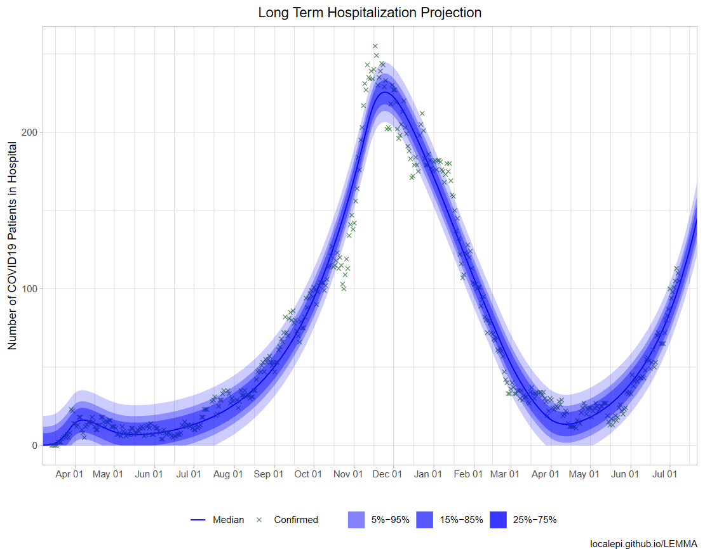
Central Region
R-Estimate: 1.09

Slide 9
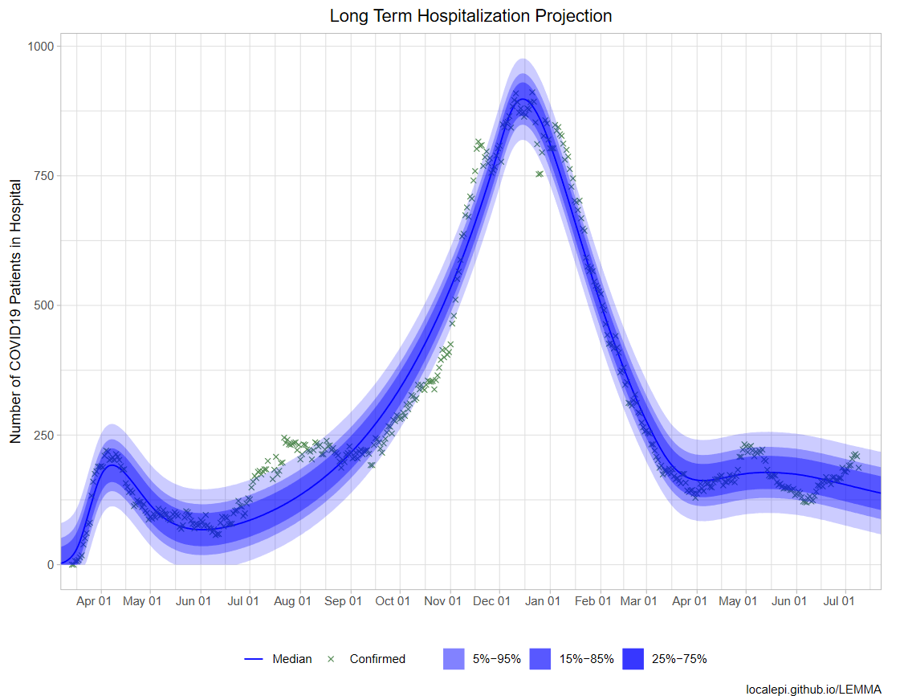
Kansas City Region
R-Estimate: 0.967

Slide 10
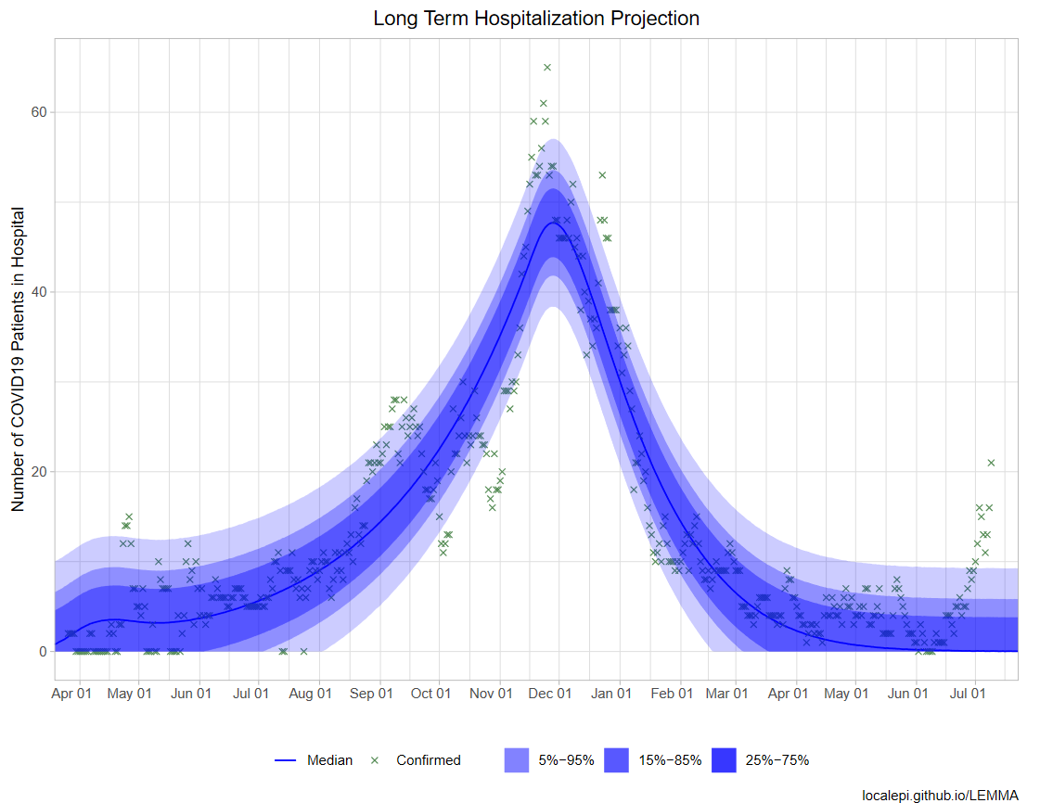
Northeast Region*
R-Estimate: 0.672
*Less reliable due to small sample

Slide 11
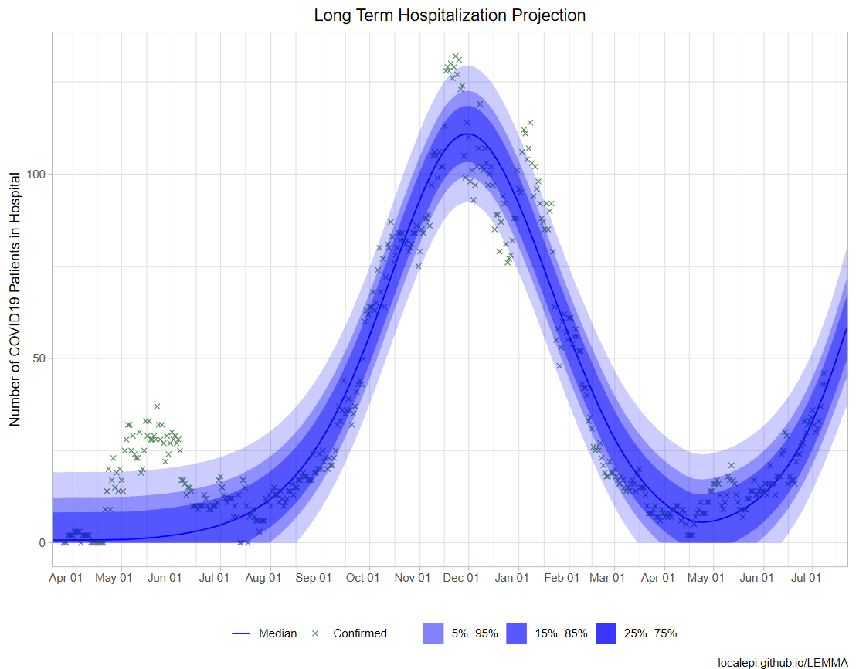
Northwest Region
R-Estimate: 1.207

Slide 12
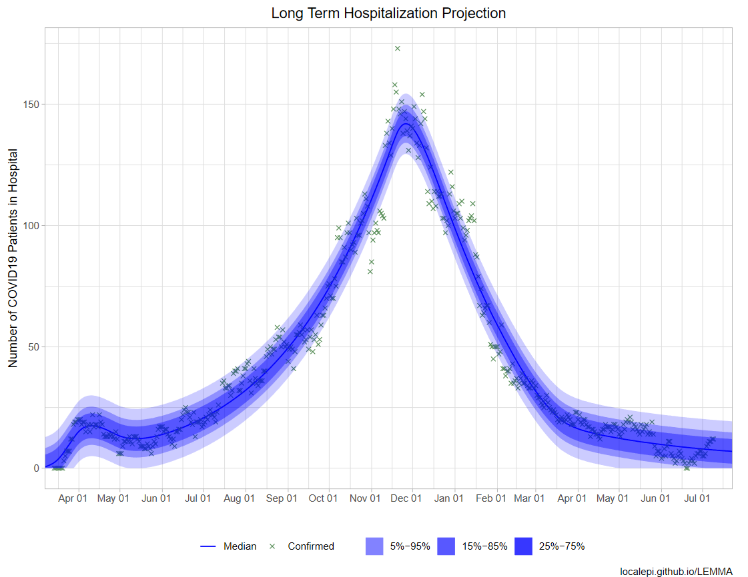
Southeast Region
R-Estimate: 0.947

Slide 13
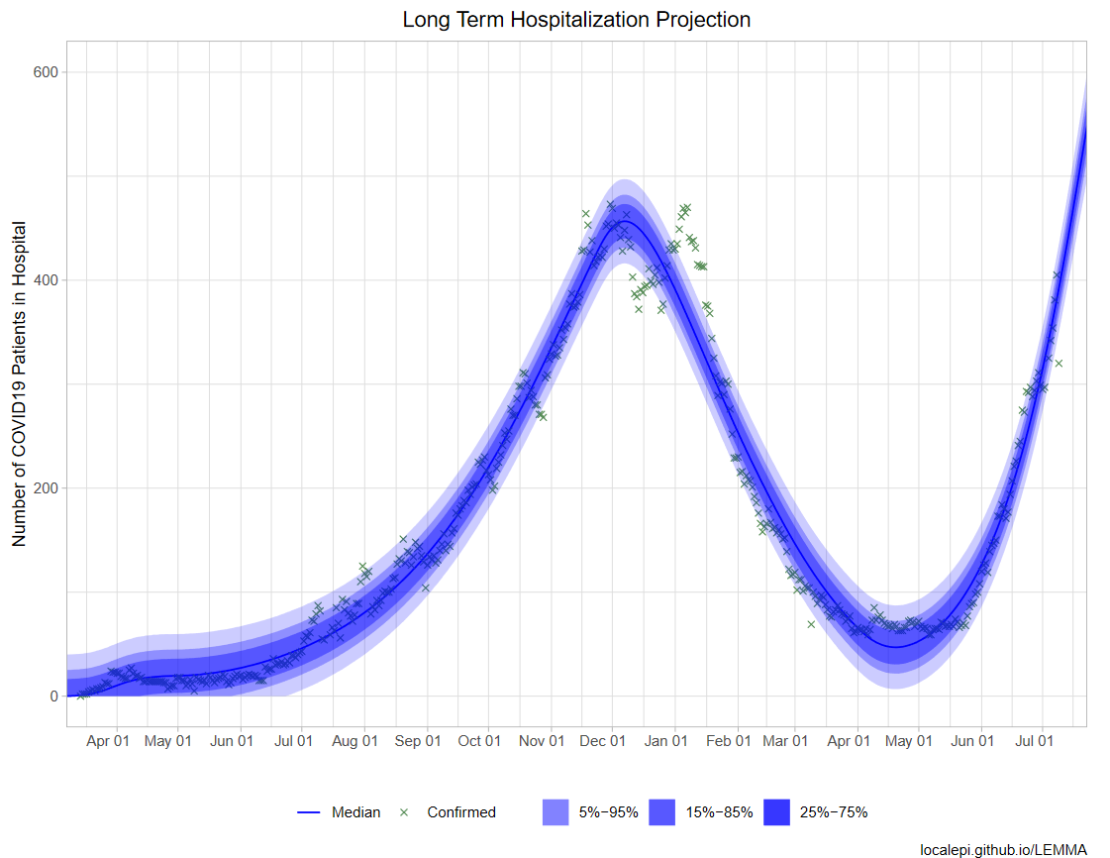
Southwest Region
R-Estimate: 1.172

Slide 14
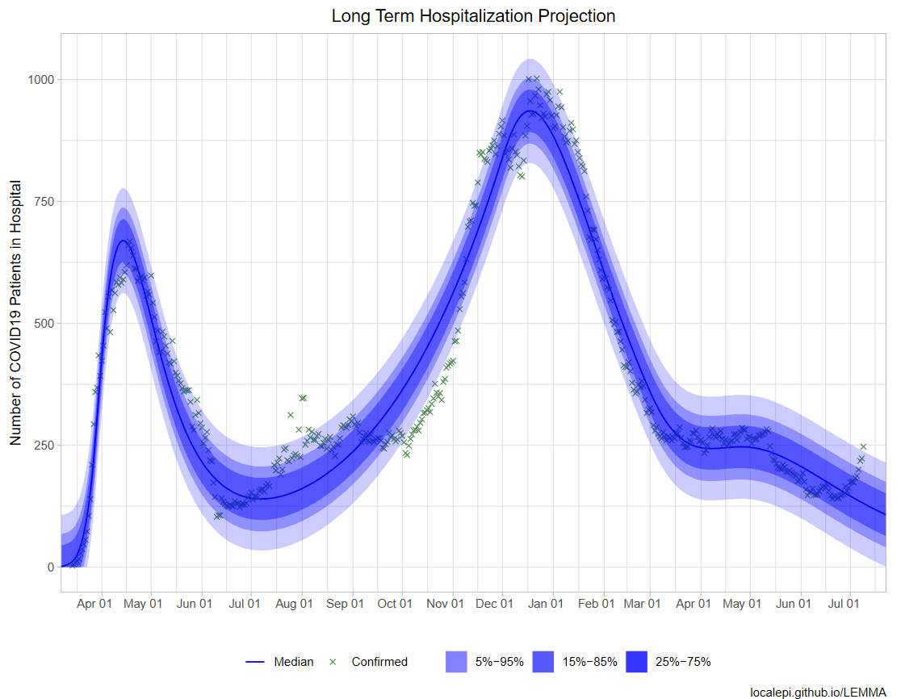
St. Louis Region
R-Estimate: 0.9

