Slide 1
Using MEDES
Background Information and Helpful Tips
Missouri Eligibility Determination and Enrollment System (MEDES)
Brian Kinkade, Director, Missouri Department of Social Services
Julie Gibson, Director, Missouri Family Support Division

Slide 2
Presenters
Julie Gibson, Director
Family Support Division, Missouri Department of Social Services
Dwight Fine, MEDES Partner Coordinator
Family Support Division, Missouri Department of Social Services
Robin Gerstner, Certified Application Counselor
Samuel U. Rodgers Health Center, Kansas City, Missouri

Slide 3
Why Help Customers Apply On-Line?
Many consumers cannot navigate the on-line application without your help.
Because it is easy, and they get a much faster decision from FSD.
It reduces the backlog of pending applications at FSD.
We get approvals in less than a month.

Slide 4
mydss.mo.gov

Slide 5
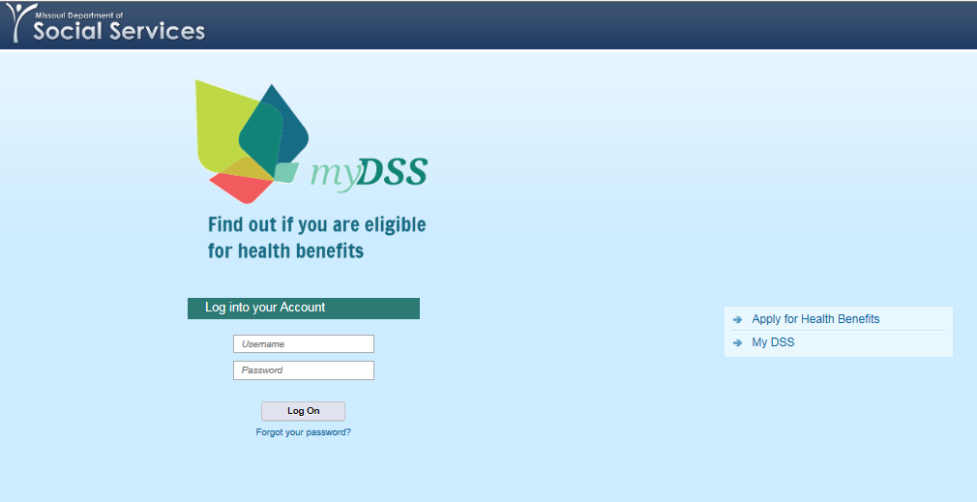
“Apply for Health Care” or “Login to a Health Benefit Account”

Slide 6
Apply for Health Benefits Pre-screening Calculator

Slide 7
Pre-screening Results & Creating an Account

Slide 8
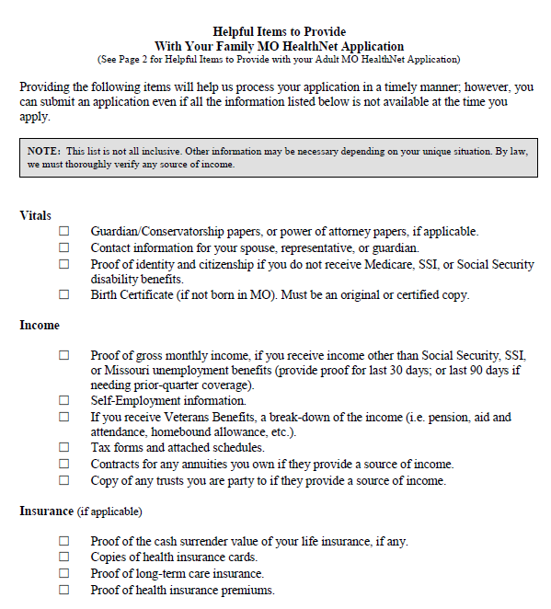
“Application Checklist” MAGI & Adult

Slide 9
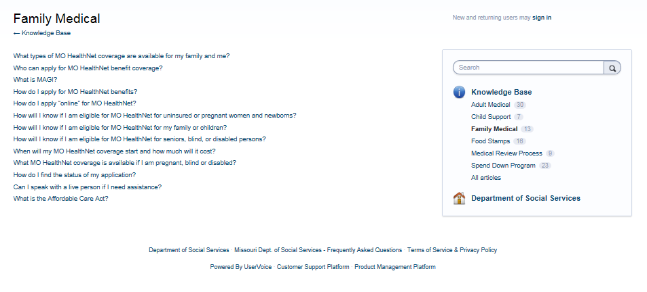
Frequently Asked Questions
FAQs cover several topics related to FSD programs.
Search by any “word” or “phrase.”

Slide 10
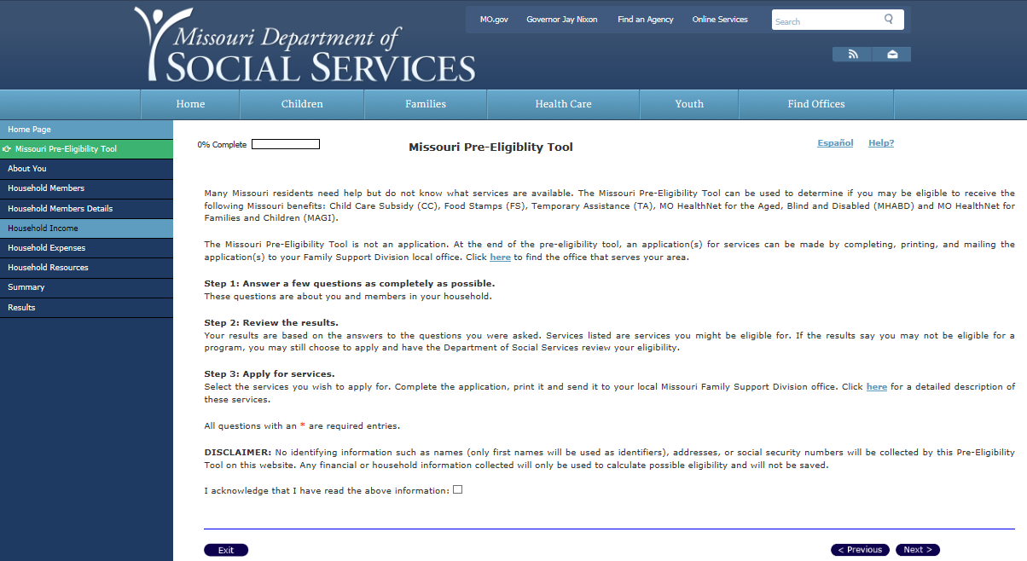
“What Other Benefits Do I Qualify For?” Pre-Eligibility Tool

Slide 11
Authorized Representative
Submit Applications
Track Applications
Submit Supporting Documentation

Slide 12
Authorized Representatives Can Track Consumer Applications
Track your consumer’s on-line applications and check your client’s ACTIVE status using EMOmed, MO HealthNet’s portal system.
Assisters working for Health Centers can register for EMOmed using their Health Center’s NPI number.
Consumers fill out the Authorized Representative form (IM-6AR), so assisters can advocate for them on-line and over the phone with FSD.
If your consumer’s application is pending for more than 30 days, contact FSD.MEDES@dss.mo.gov

Slide 13
Authorized Representative Forms
IM-6AR: The Authorized Representative form can be used to appoint an individual or organization to represent the customer.
http://dss.mo.gov/fsd/formsmanual/pdf/im-6ar.pdf
IM-6ARR: The Authorized Representative Revocation form is used to remove the appoint an individual or organization from representing the customer.
http://dss.mo.gov/fsd/formsmanual/pdf/IM-6ARR-IM-Authorized-Representative-Revocation.pdf

Slide 14
Supporting Documents Required (Verification and Evidence by FSD)
Remember to scan and submit:
Driver’s License or government-issued photo ID of anyone over 17 years old in the household.
Social Security number for anyone in the household.
Birth Certificates for any children (under 18 yrs.) in the household (if born outside of Missouri).
Permanent Resident Cards for legal immigrants (if applicable), or Certificate of Naturalization or Citizenship (if applicable)
Income Verification:
Self-employment: Most recent federal income tax return, including Schedule C.
Earned income: Pay stubs for one month (five if paid weekly and three if paid biweekly).
If Unemployed: Denial letter from Dept. of Unemployment, or a form (IM-12) filled out by last employer.
If parent’s earned income makes children CHIP eligible: Two insurance quotes (IM-5).

Slide 15
Supporting Documents Required (Verification and Evidence by FSD)
Always Try to Scan/Send Everything at Once.
If you must send separately, always include the cover page and first page of the application.
Acting As Your Own Authorized Representative (IM-6AR)
Electronically fill in all of the designated sections with:
Your name, Phone & Address.
CHECK: YES and APPLICATION. You are acting as an Authorized Representative for THIS application ONLY.
Fill out the bottom of the form with Name, Address, and Phone.
Your Name will be used to apply for benefits, and YOU will sign your name at the end of the Application.

Slide 16
When Serving as an Authorized Representative
Access consumer’s information on EMOmed, using name, date of birth or DCN #.
Verify consumer’s DCN #.
Verify Consumer’s Address. If incorrect, file a Change of Address form.
Verify ACTIVE status.
If status is Active, and consumer has not designated a Managed Care Provider, help them call 1-800-348-6627 and select number one.

Slide 17
Social Security Documentation
A Social Security number is recommended, but not required for applying or gaining Medicaid coverage for parents or their children.
A parent can apply on behalf of their U.S. born child even if the parent is undocumented.
A Social Security number is required to maintain Medicaid coverage.
Consumers have 90 days to produce a Social Security number or a letter from SSA stating they have applied and are waiting to receive their cards. Failure to provide this information will result in termination of benefits.
Uploading this letter is sufficient for keeping the coverage from being terminated.

Slide 18
Unique CHIP Issues
Children’s Health Insurance Program (CHIP)
CHIP monthly premium payment is the same, regardless of the number of children. Example: If the payment is $28, it is $28 a month, even if there are 3 children in the family. It is NOT $28 per child.
If a premium is due, coverage will not commence until the premium is paid.
If you have questions, call the CHIP Payment Center: 1-877-888-2811
CHIP Payment Vouchers have the payment voucher for the next month attached to the bottom. This eliminates mailing out a voucher each and every month.
Tell your clients!
CHIP- ME Code 71, 72: No Premium CHIP Coverage.
CHIP-Coded 73, 74, 75: Premium CHIP Coverage. Will close out when non-payment reaches 90 days. Medicaid will quit mailing payment vouchers after 3 months, but the client’s Medicaid can be activated by a payment.

Slide 19
A Completed Packet Includes
Verification Cover Sheet: Mark if it is . . .
MHK - MO HealthNet for Kids
MHF - MO HealthNet for Families
MPW - Medicaid for Pregnant Women, or
UWHS - Uninsured Women’s Health Services.
First page of printed MO HealthNet application.
Authorized Representative Form.
MO HealthNet -Rights and Responsibilities Signed by Applicant.
ALL previously mentioned documentation needed to support the application.

Slide 20
Queue Management

Slide 21
QUEUE MANAGEMENT PROCESS
Submission of Requests for Supporting Documentation
We established the following email accounts to use when submitting documentation to FSD MAGI Processing Centers.
The email addresses channel your documentation to the appropriate queue to expedite processing.

Slide 22
Contact Information | Purpose
FSD.MEDES@dss.mo.gov | To be used for to submit requests to the MEDES system for coverage for the following: Newborns; Patients with emergency care requirements who need applications promptly processed; Pregnant women with high risk pregnancies; and, Emergency Medical Care for Ineligible Aliens (EMCIA) applications.
 | To be used by FFM Navigators and Assistors to submit supporting documents for applications submitted electronically through the FFM
 | To be used (by community health centers and other qualified entities that are authorized to complete presumptive eligibility applications) to submit: TEMP (presumptive eligibility) applications for pregnant women; PE (presumptive eligibility) applications for children and adults; and, Add a Pregnancy forms for pregnant women who are a part of an active MEDES case.
 | To be used to submit: Requests for PQ or corrected dates of coverage Paper Applications Supporting documentation for applications not submitted electronically Changes in Circumstance: changes in household composition changes in income address changes Status inquiries Authorized Representative forms for applications not submitted electronically Hearing Requests Requests for Approval Letters

Slide 23
 | To be used to submit lists of old or problem applications pending more than 30 days.
 | To be used to request Prior Quarter (PQ) and/or Corrected Dates of Coverage.
 | To be used to submit lists of applications that are pending longer than: 15 days for MPW applications; and, 30 days for family applications.
 | To be used to submit supporting documentation for applications that were not submitted electronically through our web portal www.mydss.mo.gov.
FSD.MEDESHOSPITALS@dss.mo.gov | To be used by hospitals to submit supporting documentation for MAGI applications submitted electronically through our web portal www.mydss.mo.gov. This process will be discontinued once supporting documents can be uploaded with the MEDES application.
FSD.MEDESCLINICS@dss.mo.gov | To be used by community health centers and clinics to submit supporting documentation for MAGI applications submitted electronically through our web portal www.mydss.mo.gov. This process will be discontinued once supporting documents can be uploaded with the MEDES application.
FSD.MEDESLPHA@dss.mo.gov | To be used by local public health agencies to submit: TEMP (presumptive eligibility) applications for pregnant women; PE (presumptive eligibility) applications for children and adults; and, Add a Pregnancy forms for pregnant women who are a part of an active MEDES case.

Slide 24
FSD.MEDESUSERS@dss.mo.gov | To be used by partners to submit their concerns and complaints to the user assistance team.
 | To be used by partners to submit policy and process questions to the MEDES User Assistance Team. (In other words this email address may be used to send FSD information and queries that in the past you may have sent to dwight.fine@dss.mo.gov.)
 | This email address may also be used by physicians’ offices, Certified Application Counselors, and other assistors to seek information related to the status of an application or information required to complete the processing of an application or the transfer of applications between the FFM and the Medicaid program.

Slide 25
Suggested Subject Lines for documents submitted by email or fax
NOTE: Email addresses established by FSD are used to route your applications and supporting documents to the appropriate MAGI Processing Center. They will be processed by trained caseworkers.
Enter words in BOLD on the subject line for documents being submitted by email.
Use the same words on the cover sheet for documents submitted by fax.
Add a Pregnancy: You are submitting a form requesting that we add pregnancy coverage to a client who is already a part of an active MEDES case.
Backdating: This is to be used when an individual’s coverage on MXIX or MMIS does not go back to the correct date of coverage based on the application.
Emergency Coverage Needed: This is used only for those cases where care is needed immediately, inpatient stays or prescriptions are needed immediately.
EMCIA (Emergency Medical Care for Ineligible Aliens): Request for coverage for ineligible aliens for emergency medical care.

Slide 26
Suggested Subject Lines for documents submitted by email or fax
High Risk Pregnancy: Patient has risk factors indicating a high risk pregnancy.
Initial IVR Email Request: When you want to know if an application has been filed; and, if so, what is the status of the application, what information is required to complete the application process.
Newborn: Requesting coverage for a newborn using the newborn spreadsheet.
Old Applications: Applications pending more than
15 days for MPW applications; and,
30 days for family applications.
Presumptive Eligibility/TEMP Coverage: Applicant has gaps between PE/TEMP coverage and start date for Medicaid coverage.
PQ: This is used when the individual’s regular coverage start date is correct but prior quarter coverage was requested and not reflected on MXIX or MMIS.

Slide 27
DSS Encryption Service
It is necessary to encrypt applications and documents that contain any two personal identifiers submitted via email. If you don’t have encryption abilities, you can fax documents. DSS does provide encryption capabilities on its web site.
The best way to send encrypted information to FSD is to use the DSS provided encryption service.
There are directions on the DSS web site about how to send us an encrypted email. The link is http://dss.mo.gov/encrypt.htm. You will need to follow the third set of instructions on the page.

Slide 28
Remote Identity Proofing (RIDP)

Slide 29
Remote Identity Proofing (RIDP)
Individuals applying online, or creating an online account, after October 27, 2014, are subject to the RIDP process through the MEDES Citizen Portal.
Individuals applying online must answer a series of questions which only that individual would know.
If the applicant/participant fails the RIDP process, he/she will receive the following message:
“We were unable to verify your identity at this time. You will be asked identify questions the next time you log into your MyDSS account. You may also visit your local FSD Resource Center to complete the process. Please click “Next” to continue with your application for Health Benefits.”

Slide 30
Remote Identity Proofing (RIDP)
Failing the RIDP process does not prevent someone from completing their MEDES application. However, they will not be allowed to sign on to their account until the RIDP process is completed.
If the applicant/participant tries to sign into their account, the following screen message appears:
“Authentication Failed. The values you have entered are incorrect. You failed authentication. Please call (855) 373-9994 for support.”

Slide 31
Speed the Processing of Applications
File electronic applications or phone applications.
Queue.
It is NOT always necessary to file a MEDES application!

Slide 32
How You can help us!
It has been over a year since we launched our partnership.
We have more than 125 active partners, and count you as one of our valued partners.
We hope it is easy for you to access key information needed as a user of our system.
We want to encourage the filing of Electronic Applications.
We are excited about your outreach efforts.

Slide 33
Speed of Processing MAGI Applications
The following table shows success in reducing processing times and the queue of pending applications.
We feel the normal monthly queue of pending MAGI applications will remain around 5,000 per month given the number of applications that require supporting documentation.
A positive impact of the enhanced performance of our system.

Slide 34
Cumulative Queue (No FFM)
 | Cumulative-Pending (No FFM)
September 2015 | 3,866
August 2015 | 4,574
July 2015 | 3,051
June 2015 | 2,901
May 2015 | 3,074
April 2015 | 5,851
March 2015 | 6,471
February 2015 | 10,638
January 2015 | 14,282

Slide 35
What percent of applications are filed electronically?
Electronic Applications. In July, two-thirds of all applications were submitted either online or by phone. Due to your support, FSD’s initial goal of growing the number of applications submitted electronically is being progressively achieved.
For the month of July:
42% of applications submitted were created online at www.mydss.mo.gov
24% of total applications were submitted by phone.
Phone applications are becoming increasingly popular in rural areas where people have limited access to the internet.

Slide 36
Is it always necessary to file a MEDES application?
Not always.
To speed the processing of applications, FSD is identifying processes to eliminate the need to submit duplicate applications.
If a woman is already a part of an active case in MEDES, she may have pregnancy added to that active case by submitting an Add a Pregnancy form.
If the pregnant woman is NOT a part of an active MEDES case, it is important for her to complete a Medicaid application. In this case, the woman will complete two different applications – one for TEMP MPW coverage and one for Medicaid coverage.
Submit Add a Pregnancy forms by fax or email. Fax 573-751-0282 or Email fsd.medes@dss.mo.gov

Slide 39
Partnership Contact Information
At this time, Dwight Fine is working with FSD’s partners. He will answer your questions and respond to your concerns.
He may be contacted at 573-526-3288, or by email at FSD.MEDESUSERS@dss.mo.gov.
If you have problems navigating our system, or complaints about the way we process the information you submit, please let Dwight know as soon as possible. He will raise your concerns with appropriate staff.

Slide 40
Useful Information:
How are MAGI Applications Submitted
Call 855-373-9994 to Apply over the Phone
Call 855-373-4636 to check Status of your Application
Common ME Codes
Countable Income
Non-Countable Income
Allowable Deductions

Slide 41
How are MAGI applications submitted?
Online, Go to www.mydss.mo.gov
Over the phone, Call 1-855-373-9994
United States Postal Service, Use the following mailing address for MAGI applications:
PO Box 1194, Lebanon, MO 65536
Drop off paper applications at any FSD office or Resource Center. To find a location near you, Go to http://dss.mo.gov/dss_map/

Slide 42
What services can you expect by calling 855-373-9994?
This number is for individuals applying by phone for MO HealthNet for Kids, Families, Pregnant Women, and Uninsured Women's Health Services (UWHS) or seeking technical assistance for issues related to the online application process.

Slide 43
What services can you expect by calling 855-373-4636?
This number is for individuals seeking
specific case information
general program information
status of their application/case
Or, you may contact a local FSD office or Resource Center. Following this link to locate the nearest office: http://dss.mo.gov/dss_map/

Slide 44
Countable Income Includes:
Countable income includes:
Taxable Wages/Salary (before taxes are taken out)
Pretax contributions to dependent care accounts, health insurance premiums, flexible spending accounts, retirement accounts and commuter expenses are NOT included as income.
Self-Employment - Profit once expenses are paid
Social Security Benefits
Unemployment Benefits
Alimony Received
Most Retirement Benefits
Interest - Including tax-exempt interest
Net Capital Gains
Most Investment income
Rental or royalty income
Other taxable income
Lump sum is only counted in the month received
Income of child under 19 who is required to file taxes, as his/her income equals or exceeds the federal tax filing threshold
NOTE: Refer to “Helpful Items Checklist” on slide #8.

Slide 45
Non-Countable Income Includes:
Non-Countable income includes:
Temporary Assistance and other government cash assistance
Supplemental Security Income (SSI)
Child Support Received
Veteran’s Benefits
Workers Compensation Payments
Proceeds from life insurance, accident insurance, or health insurance
Federal tax credits
Scholarships, awards, or fellowship grants used for education, but not living expenses
American Indian/Alaskan Native income derived from distribution, payments, ownership interests, and real property usage rights
Income of a child under age 19 who is not required to file taxes, as his/her income is less than the federal tax filing threshold
NOTE: Refer to “Helpful Items Checklist” on slide #8.

Slide 46
Allowable Deductions Include:
Allowable Deductions Include:
Educator expenses
Certain business expenses of reservists, performing artists, and fee-basis government officials
Health Savings Account deductions
Moving Expenses
Deductible part of self-employment tax
Self-employed SEP, SIMPLE, and qualified plans
Self-employed health insurance deduction
Penalty on early withdrawal of savings
Alimony paid
IRA deduction
Student loan interest deduction
Tuition and fees
Domestic production activities deduction
NOTE: Refer to “Helpful Items Checklist” on slide #8.

Slide 47
COMMON ME CODES FOR WOMEN AND BENEFITS COVERED
ME Code | Medicaid Category | Age | Benefits
05, 06 | MO HealthNet for Families (MAF) | Any age | State plan services
05,06 | Transitional MO HealthNet (TMH) | Any age | State plan services
40 | MO HealthNet for Kids (MHK) | > age 19 | State plan services
71, 72, 73, 74, 75 | Children's Health Insurance Program (CHIP) | > age 19 | State plan services plus dental and vision but may be subject to a premium
45, 18, 61 | MO HealthNet for Pregnant Women (MPW) | Any age | State plan services plus dental and vision
43, 44 | Post Partum | Any age | State plan services plus dental and vision
89 | Uninsured Women's Health Services (UWHS) | 18 - 55 | Family planning services only
80 | Extended Women's Health Services (EWHS) | 18 - 55 | Family planning services only
87 | Presumptive Eligibility for Kids (PE) | > age 19 | State plan services
58,59 | Temporary MO HealthNet for Pregnant Women (TEMP) | Any age | Does not include inpatient services
State Plan Services: physician and hospital services, emergency services, prescription drugs and other health related services -- in addition, children get dental and vision

